Slide 1
5. Linked List - Part 2
ECE 309
Dr. James Tuck

Slide 2
Objectives
Explain the syntax for out-of-class member function definitions
Implement code to remove a node from a list
Traverse a linked list using an iterator
Insertion and removal at arbitrary locations using an iterator; time complexity

Slide 3
Out of class member function definitions
// class declaration
class T {
int some_function(); // member function declaration
};
// member function definition outside of the class
int T::some_function()
{
}
To explain that some_function() is a member function of some class T, add T:: to the beginning of its name in the definition.
This is the namespace scope operator (::)
We re-use it here to identify class scope.

Slide 4
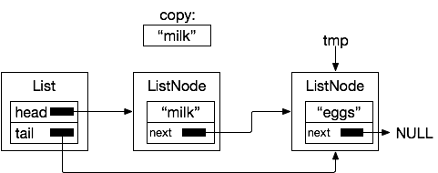
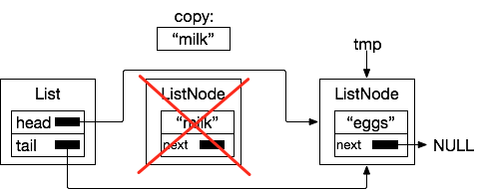
List::remove
bool List::remove(Item &copy)
{
if (!empty()) // if list is not empty
{
copy = head->item; // return copy
ListNode *tmp = head->next;
delete head; // delete the node
head = tmp; // update the head
if (tmp==NULL) // removed last element
tail = NULL;
return true;
}
return false; // nothing in list
}

Slide 5

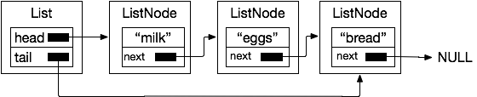
List::empty
bool List::empty()
{
// if head is NULL, list is empty
return head==nullptr;
}
Empty!
Not empty!

Slide 6
Example
Use the List object to make a list of strings and print them out.
List l;
l.append(Item("milk"));
l.append(Item("eggs"));
l.append(Item("bread"));

Slide 7
Refining the C++ code a bit
The ListNode object is only used by the List object.
Can we guarantee that no other part of the code uses the ListNode class other than List?
Answer: Yes, make the class declaration a private member of List.

Slide 8
ListNode as a private member of List
class List {
private:
// ListNode represents each
// node of the list
class ListNode {
private:
Item item; // data in the list
ListNode *next;
ListNode(Item a) { item = a; }
};
// add head and tail pointer
ListNode *head;
ListNode *tail; // continued on next column.
public:
List();
void append(Item a);
bool remove(Item &a);
bool empty();
}; // end class List

Slide 9
List::~List()
List::~List()
{
// Free all of the ListNodes in the list
Item t;
while(!empty()) // while not empty
remove(t); // remove the next node
}

Slide 10
Linked list traversal
Sometimes we need to visit each node of a linked list in order
To check for existence of item (e.g. is milk on my list?)
To determine where to insert a new item
To decide if an item needs to be removed
This is called traversal of the list

Slide 11
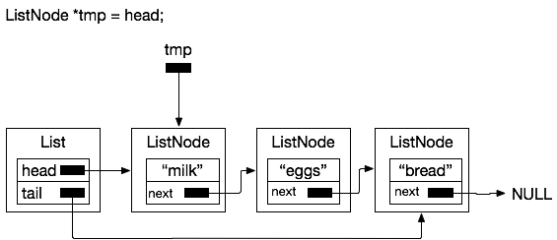
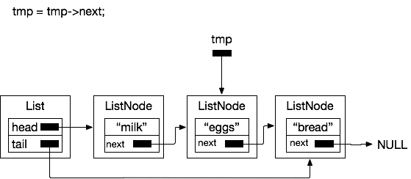
Traversal approach
Visit each node of the linked list one at a time by following the next pointer

Slide 12
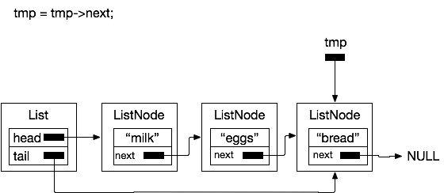
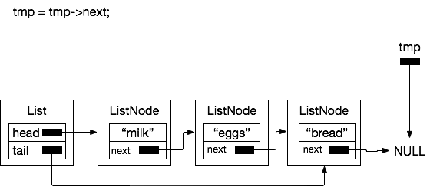
Traversal approach
(1)
(2)
(3)
(4)

Slide 13
Traversal in code
ListNode *tmp = head;
while(tmp!=nullptr) // not at end of list
{
// get the item out and use it if needed
// go to next node in the list
tmp = tmp->next;
}

Slide 14
Issues with that approach
Pros:
Client code is in control of the traversal
Cons:
Clients of the List object don’t have access to ListNode objects because we made ListNode private
We don’t want clients of List to have to understand the underlying structure of List (next field, etc) to traverse it

Slide 15
Solution: the iterator object
An iterator object allows us to traverse and access objects in a data structure.
// declared public inside List
class iterator {
private:
ListNode *node; // private, implementation details hidden
public:
iterator(ListNode *n=nullptr) { node = n; }
Item& getItem() { return node->getItem(); }
void next() { node = node->next; }
bool end() { return node==nullptr; }
};

Slide 16
Using the iterator object
List l;
// add stuff to l
List::iterator i = l.begin(); // initialize iterator to the beginning of l
while(!i.end())
{
Item &item = i.getItem(); // get the item
i.next(); // increment to next node in the list
}

Slide 17
Initializing the iterator
The iterator object doesn’t have access to head or tail of the list, but the List object does
The List object must produce the iterator initialized to the head
// Return an iterator to the beginning of the list
List::iterator List::begin() // member of List object
{
// create an iterator object that points at the head of the list
// if head is NULL, the iterator.end() will return true
return iterator(head);
}

Slide 18
Why did we use an iterator object?
We don’t want to force the client to understand the details of our List implementation
The iterator can know how List works without revealing it by hiding those details as private
The iterator allows the client to control iteration: start it, stop it, and use any kind of loop it wants
Important: Iterators are a common C++ idiom; we’ll see them over and over again as we make data structures

Slide 19
Complexity of Linked List operations
Operation (assume List of length n) | Time Complexity | Explanation
append to tail | O(1) | The append function has no loop. It allocates a new node and updates two pointers. This time cost is fixed to a few statements. Since it’s constant number of operations, it’s O(1)
remove from head | O(1) | Similar argument for appending. O(1)
empty | O(1) | Checking the head for nullptr has a fixed cost.
traversal (next) | O(1) | Moving from one node to the next node in the list takes a fixed number of operations.

Slide 20
References
1. ZyBook on Data Structures, chapters 11.1-11.4, 11.10

